Slide 1
Practical/Hands-On
Read/write
Conversions
Plotting using pyPlot

Slide 2
Programming Language

Slide 3
Python

Slide 4
Why Python
General-purpose language
Great for backend
Web development
Data analysis
Artificial intelligence
Scientific computing
Plenty of resources

Slide 5
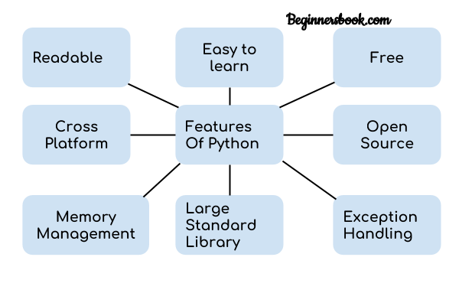
Python
https://beginnersbook.com/2018/01/introduction-to-python-programming/

Slide 6
Tools

Slide 7
Anaconda

Slide 8
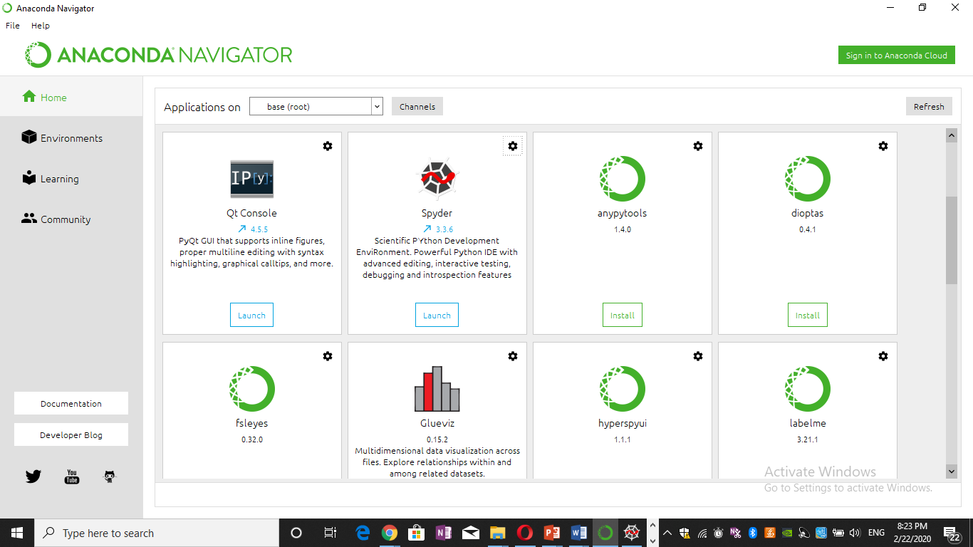

Slide 9
Python Editor
Download Anaconda python 3.7 https://www.anaconda.com/distribution/#download-section
Use anaconda Navigator to choose your editor:
- We recommend to use Spyder Editor
- Press launch to start writing code

Slide 10
Python Editor
Use anaconda command to install new package online or offline using command
pip install package name
Ex. Download opencv.whl in your local machine
install pckage by using this command::
pip install desktop\opencv_python-4.2.0.32-cp37-cp37m-win_amd64.whl

Slide 11
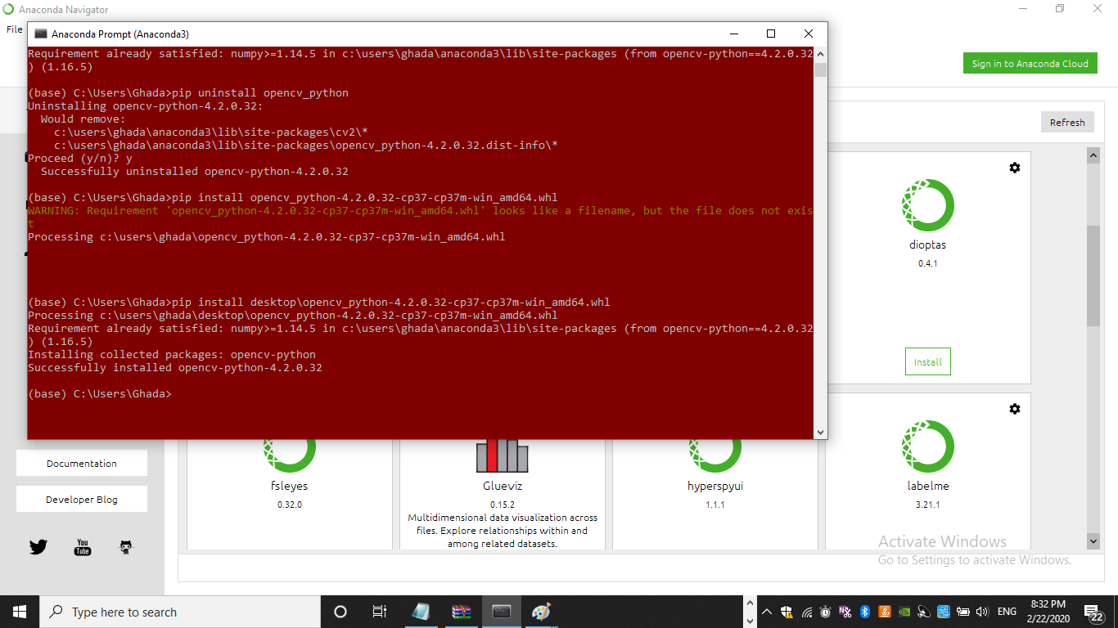

Slide 12
Why Anaconda
It comes with many powerful packages
While traditional Python gives you just a basic platform where you have to install your desired packages manually

Slide 13
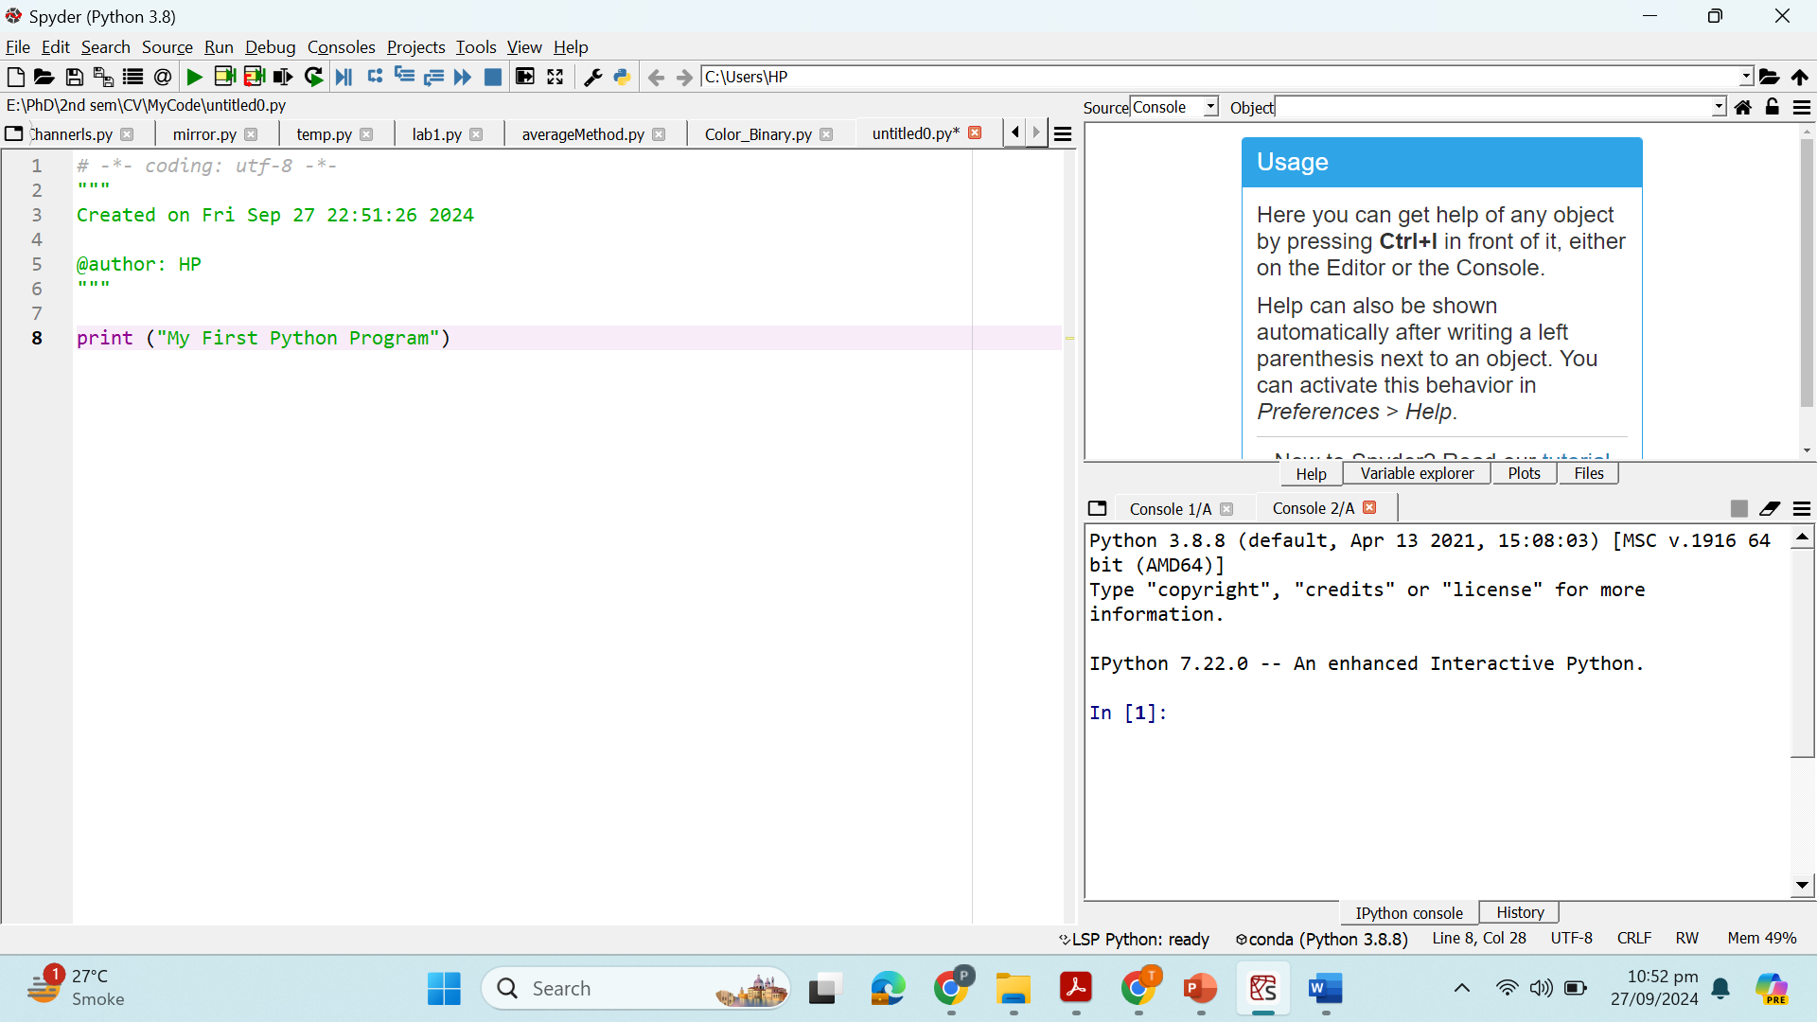
IDE Spyder

Slide 14
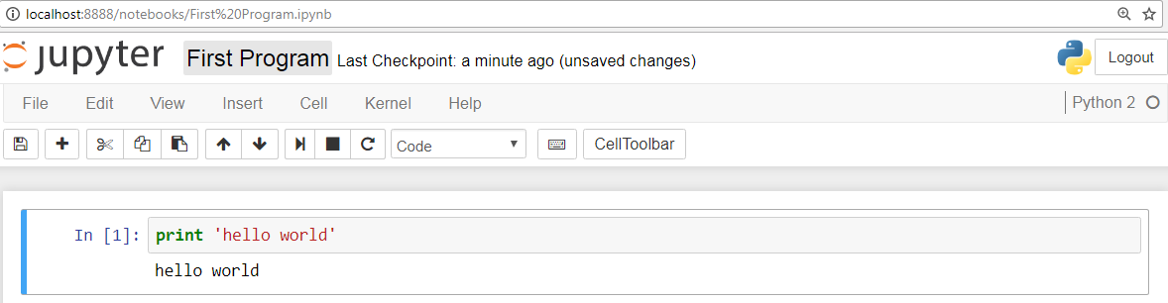
IDE (Jupyter Notebook)

Slide 15
Download and install Anaconda with Jupyter(Notebook) and Spyder(IDE)
https://www.anaconda.com/download
Python programs written in spyder will have an extension “.py”
Programs written in Jupyter will be saved as “.ipynb”
You may use Google Colab (Online Environment)

Slide 16
Jupyter NoteBooks
Jupyter Notebook App (formerly IPython Notebook) is an application running inside the browser.
A web application which allows you
To create and share documents
That can contain live code, text, visualizations
Easy to jumpstart
Brings together an analysis and it’s results
Offers real time data analysis
"Jupyter" : a loose acronym meaning Julia, Python, and R
Run it in Docker or in CMD
Notes:
docker run --rm -it -p 8888:8888 -v "$(pwd):/notebooks" jupyter/not
https://www.datacamp.com/community/tutorials/tutorial-jupyter-notebook#gs.PU2kftE
What is a jupyter notebook Running the jupyter notebook https://jupyter-notebook-beginner-guide.readthedocs.io/en/latest/execute.html
https://unidata.github.io/online-python-training/notebook.html

Slide 17
NoteBooks: Toggeling Py2 and 3
Toggling Between Python 2 and 3 in Jupyter Notebooks
Alternate between two
# Python 2.7 conda create -n py27 python=2.7 ipykernel
# Python 3.5 conda create -n py35 python=3.5 ipykernel
Restart the application and the two kernels are there for you
Activate or De-activate
source activate py27
source deactivate
Notes:
Running R in your notebook
conda install -c r r-essentials

Slide 18
Libraries
Image Processing and Computer Vision

Slide 19
OpenCV
It stands for Open Source Computer Vision Library. This library consists of around 2000+ optimised algorithms that are useful for computer vision and machine learning. There are several ways you can use opencv in image processing, a few are listed below:
Converting images from one color space to another i.e. like between BGR and HSV, BGR and gray etc.
Performing thresholding on images, like, simple thresholding, adaptive thresholding etc.
Smoothing of images, like, applying custom filters to images and blurring of images.
Performing morphological operations on images.
Building image pyramids.
Extracting foreground from images using GrabCut algorithm.
Image segmentation using watershed algorithm.
Refer to this link for more details.

Slide 20
Beware!!
#OpenCV uses BGR color order
Just be careful while manipulating image using different kind of libraries (other use RGB)

Slide 21
Scikit-image
It is an open-source library used for image preprocessing. It makes use of machine learning with built-in functions and can perform complex operations on images with just a few functions.
It works with numpy arrays and is a fairly simple library even for those who are new to python. Some operations that can be done using scikit image are :
To implement thresholding operations use try_all_threshold() method on the image. It will use seven global thresholding algorithms. This is in the filters module.
To implement edge detection use sobel() method in the filters module. This method requires a 2D grayscale image as an input, so we need to convert the image to grayscale.
To implement gaussian smoothing use gaussian() method in the filters module.
To apply histogram equalization, use exposure module, to apply normal histogram equalization to the original image, use equalize_hist() method and to apply adaptive equalization, use equalize_adapthist() method.
To rotate the image use rotate() function under the transform module.
To rescale the image use rescale() function from the transform module.
To apply morphological operations use binary_erosion() and binary_dilation() function under the morphology module.

Slide 22
PIL/pillow
PIL stands for Python Image Library and Pillow is the friendly PIL fork by Alex Clark and Contributors. It’s one of the powerful libraries. It supports a wide range of image formats like PPM, JPEG, TIFF, GIF, PNG, and BMP.
It can help you perform several operations on images like rotating, resizing, cropping, grayscaling etc. Let’s go through some of those operations
To carry out manipulation operations there is a module in this library called Image.
To load an image use the open() method.
To display an image use show() method.
To know the file format use format attribute
To know the size of the image use size attribute

Slide 23
PIL/pillow
To know about the pixel format use mode attribute.
To save the image file after desired processing, use save() method. Pillow saves the image file in png format.
To resize the image use resize() method that takes two arguments as width and height.
To crop the image, use crop() method that takes one argument as a box tuple that defines position and size of the cropped region.
To rotate the image use rotate() method that takes one argument as an integer or float number representing the degree of rotation.
To flip the image use transform() method that take one argument among the following: Image.FLIP_LEFT_RIGHT, Image.FLIP_TOP_BOTTOM, Image.ROTATE_90, Image.ROTATE_180, Image.ROTATE_270.

Slide 24
Numpy
With this library you can also perform simple image techniques, such as flipping images, extracting features, and analyzing them.
Images can be represented by numpy multi-dimensional arrays and so their type is NdArrays. A color image is a numpy array with 3 dimensions. By slicing the multi-dimensional array the RGB channels can be separated.
Below are some of the operations that can be performed using NumPy on the image (image is loaded in a variable named test_img using imread).
To flip the image in a vertical direction, use np.flipud(test_img).
To flip the image in a horizontal direction, use np.fliplr(test_img).
To reverse the image, use test_img[::-1] (the image after storing it as the numpy array is named as <img_name>).
To add filter to the image you can do this:
Example: np.where(test_img > 150, 255, 0), this says that in this picture if you find anything with 150, then replace it with 255, else 0.
You can also display the RGB channels separately. It can be done using this code snippet:
To obtain a red channel, do test_img[:,:,0], to obtain a green channel, do test_img[:,:,1] and to obtain a blue channel, do test_img[:,:,2].

Slide 25
Mahotas
It is a computer vision and image processing library and has more than 100 functions. Many of its algorithms are implemented in C++. Mahotas is an independent module in itself i.e. it has minimal dependencies.
Currently, it depends only on C++ compilers for numerical computations, there is no need for NumPy module, the compiler does all its work.
Here are names of some of the remarkable algorithms available in Mahotas:
Watershed (https://mahotas.readthedocs.io/en/latest/distance.html)
Morphological Operations (https://mahotas.readthedocs.io/en/latest/morphology.html)
Hit & miss, thinning. (https://mahotas.readthedocs.io/en/latest/api.html#mahotas.hitmiss)
Colorspace Conversions (https://mahotas.readthedocs.io/en/latest/color.html)
Speeded-Up Robust Features (SURF), a form of local features. (https://mahotas.readthedocs.io/en/latest/surf.html)
Thresholding. (https://mahotas.readthedocs.io/en/latest/thresholding.html)

Slide 26
Mahotas
Convolution. (https://mahotas.readthedocs.io/en/latest/api.html)
Spline interpolation (https://mahotas.readthedocs.io/en/latest/api.html)
SLIC superpixels. (https://www.pyimagesearch.com/2014/07/28/a-slic-superpixel-tutorial-using-python/)
Let’s look at some of the operations that could be done using Mahotas:
To read an image use imread() method.
To calculate the mean of the image use the mean() method.
Eccentricity of an image measures the shortest length of the paths from a given vertex v to reach any other vertex w of a connected graph. To find the eccentricity of an image, use the eccentricity() method under the features module.
For dilation and erosion on the image use, dilate() and erode() method under morph module.
To find the local maxima of the image use locmax() method.

Slide 27
Matplotlib
Visualization

Slide 28
Let’s begin working with images
Read_Image
Print_Image
Copy_Image
Set_pixel
Get_Pixel
rgb_to_grayscale(image im)
Rotate
Flipping

Slide 29
Use PIL to read image and print Image Size
from PIL import Image
filename = "images/cat_hat.jpg"
with Image.open(filename) as image:
width, height = image.size
print(image.size)
print(width,height)
#Image.size gives 2-tuple and the width, height can be obtained
OUTPUT:
(300, 168)
300 168

Slide 30
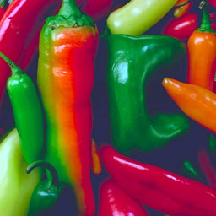
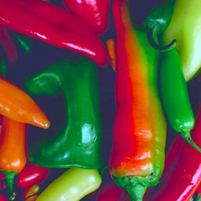
Read Image Rotate and Save
from PIL import Image
def main():
try:
#Relative Path
img = Image.open("images\peppers.png")
#Angle given
img = img.rotate(180)
#Saved in the same relative location
img.save("rotated_peppers.png")
except IOError:
pass
if __name__ == "__main__":
main()
Original
Rotated

Slide 31
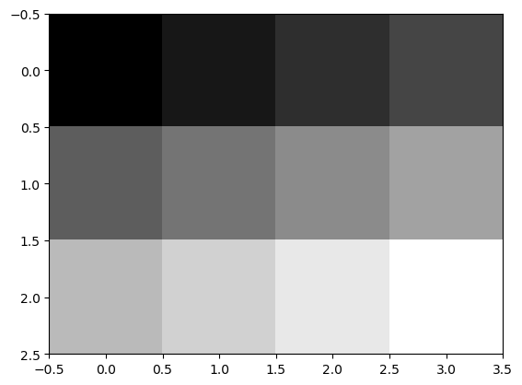
Python Example
OUTPUT
My First Python Program
[[ 0 1 2 3]
[ 4 5 6 7]
[ 8 9 10 11]]
0 | 1 | 2 | 3
4 | 5 | 6 | 7
8 | 9 | 10 | 11
import numpy as np
import matplotlib.pyplot as plt
print ("My First Python Program")
f = np.arange(12).reshape(3,4)
print(f)
plt.imshow(f, cmap='gray', interpolation='nearest’)
#plt.axis('off')
plt.show()

Slide 32
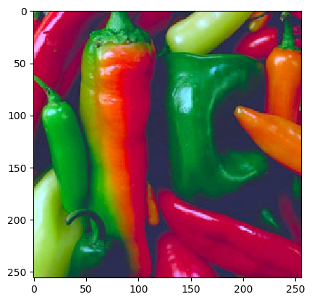
f = plt.imread('images/peppers.png’)
plt.imshow(f)
plt.show()
print(f.shape)
##output=(256, 256, 3)
The shape of a color image array thus is M×N×3

Slide 33
Run and tell output?
import matplotlib.pyplot as plt
from skimage import data
from skimage.color import rgb2gray
original = data.cat()
grayscale = rgb2gray(original)
fig, axes = plt.subplots(1, 2, figsize=(8, 4))
ax = axes.ravel()
ax[0].imshow(original)
ax[0].set_title("RGB")
ax[1].imshow(grayscale, cmap=plt.cm.gray)
ax[1].set_title("Grayscale")
fig.tight_layout()
plt.show()

Slide 34
Assignment 1
Question 1: Write 3 different Python functions that can create the images given below. Code them in such so that the size of the image itself, size of boxes, size of lines and number of horizontal and vertical lines are entered by the user.
Image 1
Image 2
Image 3

Slide 35
Assignment 1
Question 2: Write a function to create a white image size entered by the user and then create 4 boxes of Black, Blue, Green and Red respectively on each corner of the image as shown below. The size of the colored boxes should be 1/10th the size of the image. (HINT: the arrays of ones and zeros can be in more than 2 dimensions)

Slide 36
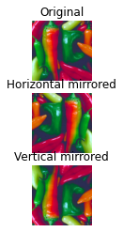
Assignment 1
Question 3: Read any image that you want and save it in gray scale. Now mirror the image that you have read at center i.e. the upper half of the image should be the copy of the lower half but mirrored. Write the image to the disk. See the image below.

Slide 37
Python[Revision]
Comments:: ‘’’ ‘’’’ #
Week Data type and Case sensitive [Variables]
num = 100
str = "BeginnersBook"
print(num)
print(str)

Slide 38
Python[Revision]
While nm = 10
while num>5:
print(num)
num -= 1
String
us = "This is a String"
s2 = 'This is also a String'
# displaying string s and its type
print(s)
print(type(s))

Slide 39
Python[Revision]
Lists
lis1 = (1, 2, 3, 4, 5)
# prints entire list
print(lis1)
# list of strings
lis2 = ("Apple", "Orange", "Banana")
# loop through tuple elements
for x in lis2:
print (x)

Slide 40
Python[Revision]
dict = {1:“Abc","lastname":“XyZ", "age":30}
# prints the value where key value is 1
print(dict[1])
# prints the value where key value is "lastname"
print(dict["lastname"])
# prints the value where key value is "age"
print(dict["age"])

Slide 41
Python[Revision]
Functions
def add(num1, num2):
return num1 + num2
sum1 = add(100, 200)
sum2 = add(8, 9)
print(sum1)
print(sum2)

Slide 42
Python[Revision]
class DemoClass:
# constructor
def __init__(self):
# initializing instance variable
self.num=100
# a method
def read_number(self):
print(self.num)
# creating object of the class. This invokes constructor
obj = DemoClass()
# calling the instance method using the object obj
obj.read_number()

Slide 43
Practise
Create a Class contains:
constructor which takes one input
Function to check if the input is number or Alph

